Slide 1
PhD Project Proposal
Modelling Business Clusters in Regions
Presentation By Yajesh Kumar
30th June 2019
LSPR © 2018

Slide 2
Agenda
A brief introduction of cluster
Factors responsible in the formation of the region
Methodology
Results and perspectives
Future recommendations

Slide 3
What Is a Cluster?
Clusters are geographic concentrations of interconnected companies and institutions in a particular field.
Clusters encompass an array of linked industries and other entities important to competition.
They include, for example, suppliers of specialized inputs such as components, machinery, and services, and providers of specialized infrastructure.

Slide 4
What Is a Cluster?
Clusters also often extend downstream to channels and customers and laterally to manufacturers of complementary products and to companies in industries related by skills, technologies, or common inputs.
Finally, many clusters include governmental and other institutions—such as universities, standards-setting agencies, think tanks, vocational training providers, and trade associations—that provide specialized training, education, information, research, and technical support.

Slide 5
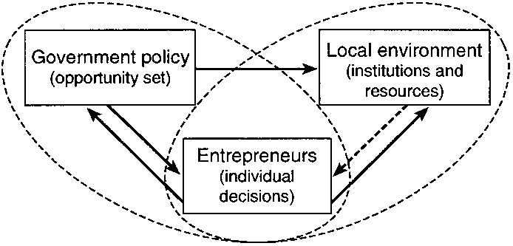
Factors in the formation of the region
Feldman et. al. (2005)

Slide 6
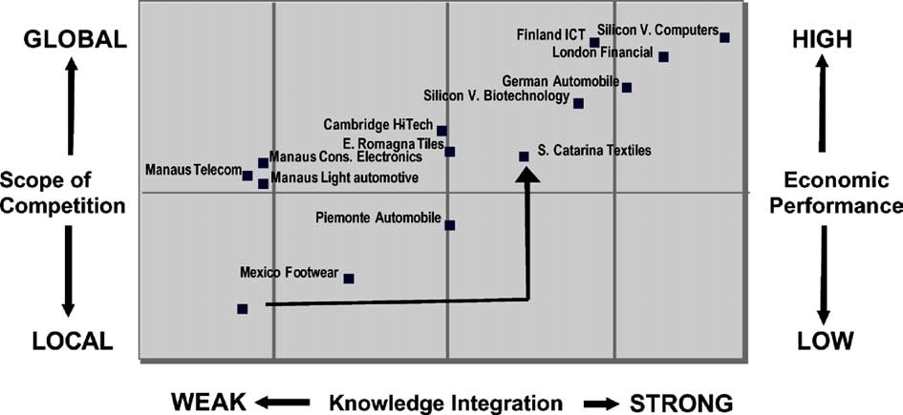
Characteristics that determine the economic performance of industrial clusters.
Morosini P. (2004)

Slide 7
Data Collection and analysis
At a micro-level, GIS will be used with real data obtained from the UK Office of National Statistics and data.gov.uk to create mashups of the (post code) locations of ‘prey’ firms onto maps
Then superimpose real "predators", using data regarding mature clusters (obtained from UKSPA, IASP etc) as well as younger nascent initiatives (from innovate UK).

Slide 8
Data Collection and analysis
At a micro-level, GIS will be used with real data obtained from the UK Office of National Statistics and data.gov.uk to create mashups of the (post code) locations of ‘prey’ firms onto maps
Then superimpose real "predators", using data regarding mature clusters (obtained from UKSPA, IASP etc) as well as younger nascent initiatives (from innovate UK).
Any missing data can be retrieved from database sources that KU routinely subscribes to, including Thomson ONE, FAME, Business Source Premier (EBSCO), Mintel Reports etc.

Slide 9
Methodology
At a micro-level, GIS will be used with real data obtained from the UK Office of National Statistics and data.gov.uk to create mashups of the (post code) locations of ‘prey’ firms onto maps
Then superimpose real "predators", using data regarding mature clusters (obtained from UKSPA, IASP etc) as well as younger nascent initiatives (from innovate UK).
Any missing data can be retrieved from database sources that KU routinely subscribes to, including Thomson ONE, FAME, Business Source Premier (EBSCO), Mintel Reports etc.

Slide 10
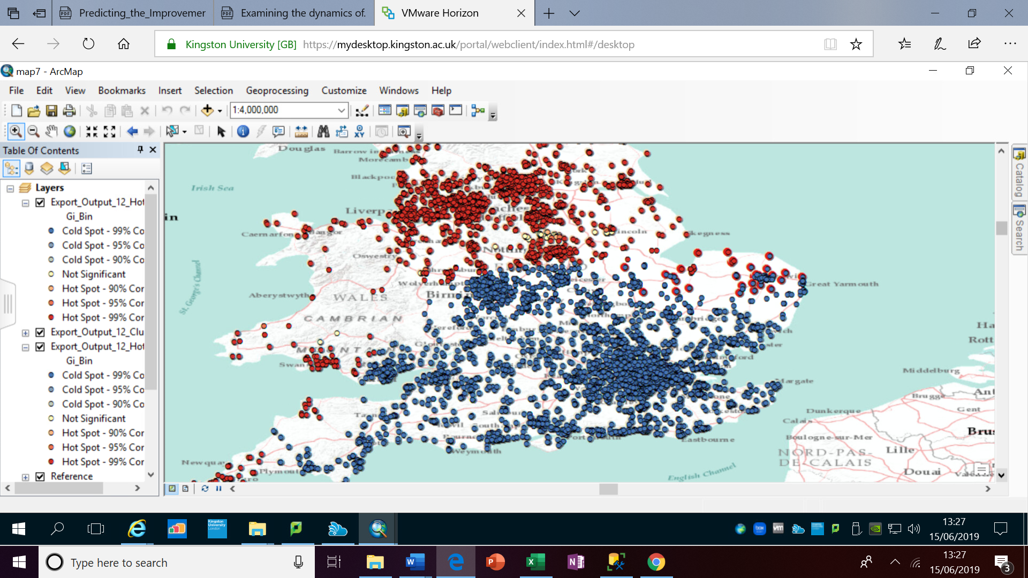
Data Collection and analysis

Slide 11
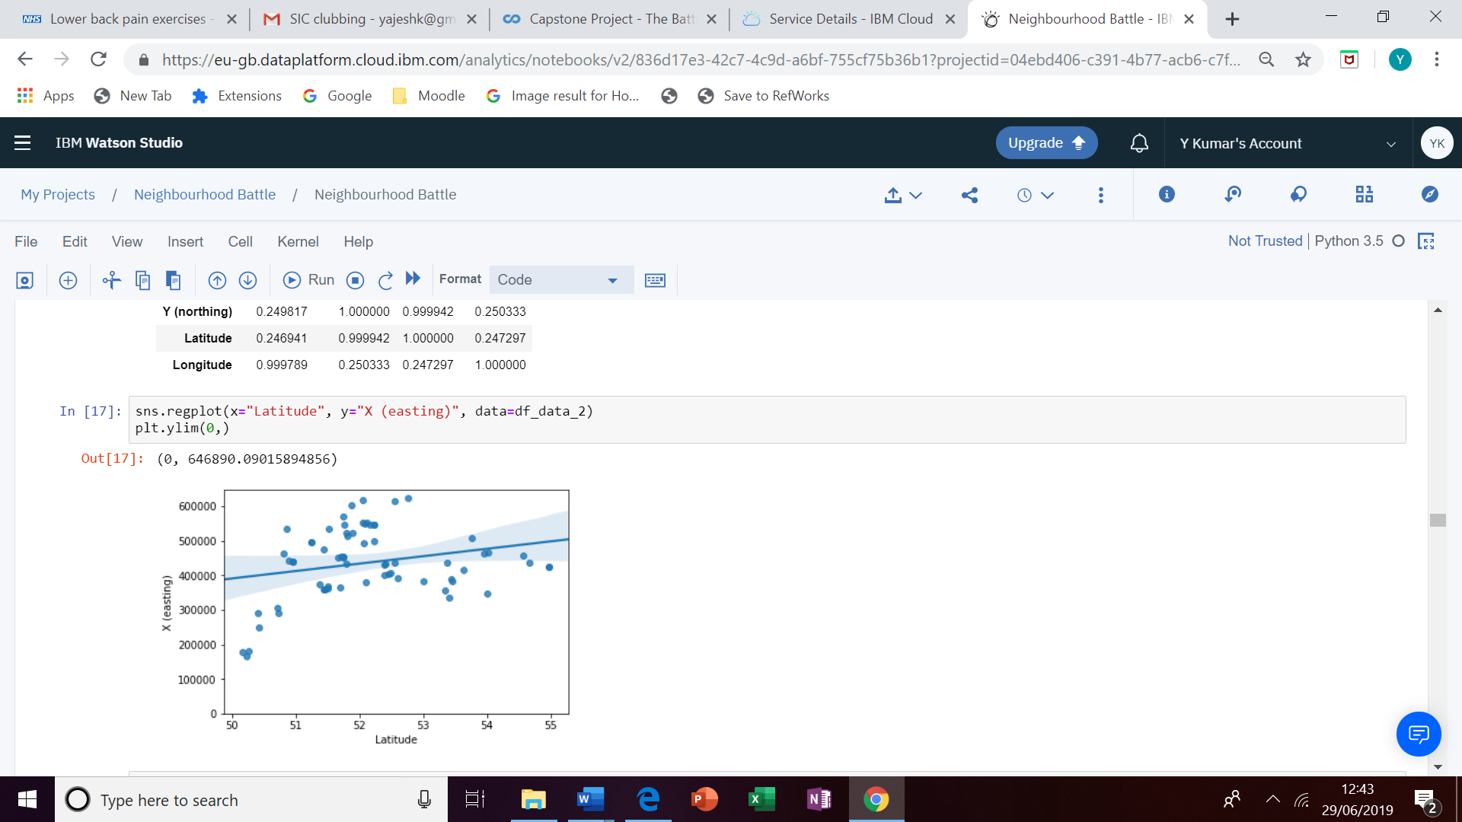
Methodology - Regression analysis

Slide 12
Results and perspectives
We can see from above Decision tree accuracy to predict the location of next UKSPA is 0.905..
The analysis was also performed using ‘K Neighbors Classifier’ algorithm and SVM and it was observed that F1 Score and Jaccard Similarity values are in the range of 0.7 which is quite good for supporting the analysis.

Slide 13
Future recommendations
Presently this project uses task-specific algorithms but in the future "Deep Learning" could be added, which in turn could establish principles for further studies
"Deep Learning" may help realize one ambitious future goal, a relatively real-time modelling business clusters in regions

Slide 14
References:
Al-Kfairy, M., Khaddaj, S. and Mellor, R.B. (2018): Computer modelling reveals the optimal organisational structure for business cluster success. Journal of economic geography
Feldman M.P., Francis J. and Bercovitz J. (2005) Creating a Cluster While Building a Firm: Entrepreneurs and the Formation of Industrial Clusters Regional Studies, Vol. 39.1, pp. 129–141, February 2005.
Morosini P. (2004) Industrial Clusters, Knowledge Integration and Performance World Development Vol. 32, No. 2, pp. 305–326, 2004.
Will, M.G., Al-Kfairy, M. and Mellor, R.B. (2018): Hierarchies, Polyarchies and Hybrids: How Organizational Structures Determine Economic Performance in a Risky Environment. Organization Science
Gov.uk
UKSPA
Company house
ESRI ARC GIS
Watson studio
MSSQL studio

Slide 15
Thank you!

